Slide 1




Planning for the Impacts of Climate Change on North Carolina’s Agricultural Sector
WORKING DRAFT
2024 AI BOOTCAMP | PROJECT 3
CONTRIBUTORS: Mike Szumski and Jamie Bond

Slide 2
CONTENTS |  | PAGE
Executive Summary |  | 3
Background |  | 4
Approach |  | 5
Modeling and Analysis |  | 5
Findings and Conclusions |  | 13
Additional Questions |  | 14
Reference Content |  | 15
PROJECT OBJECTIVE
In this project, the University of North Carolina Charlotte / Chapel Hill AI Bootcamp project team examined the impacts of weather events, particularly flooding, on North Carolina agriculture and developed predictions about future impacts of climate change driven events on the state’s agricultural sector.

Slide 3
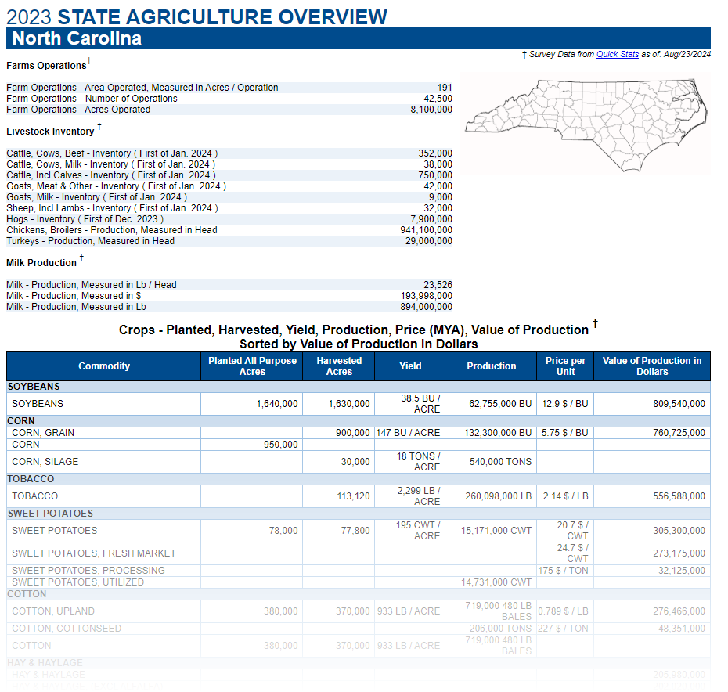


EXECUTIVE SUMMARY
PROJECT OBJECTIVE
To model the impacts of seasonal weather conditions on agricultural productivity and use the results to generate agricultural planning recommendations to local farmers.
Specifically, we aimed to develop a model for predicting yield and value of various North Carolina crops based seasonal weather forecasts which then feeds the results to a customized crop planning and protection recommendation engine for use by farmers.
PRIMARY DATA SOURCES
USDA National Agricultural Statistics Service (NASS)
National Integrated Drought Information System
NOAA Climate Perdition Center
APPROACH
Used historical weather and NC agricultural data train machine learning model to predict yields of various crops and respective market values.
Passed findings to decision model which levaged Ingested
KEY FINDINGS
Analyses revealed findings ….

Slide 4
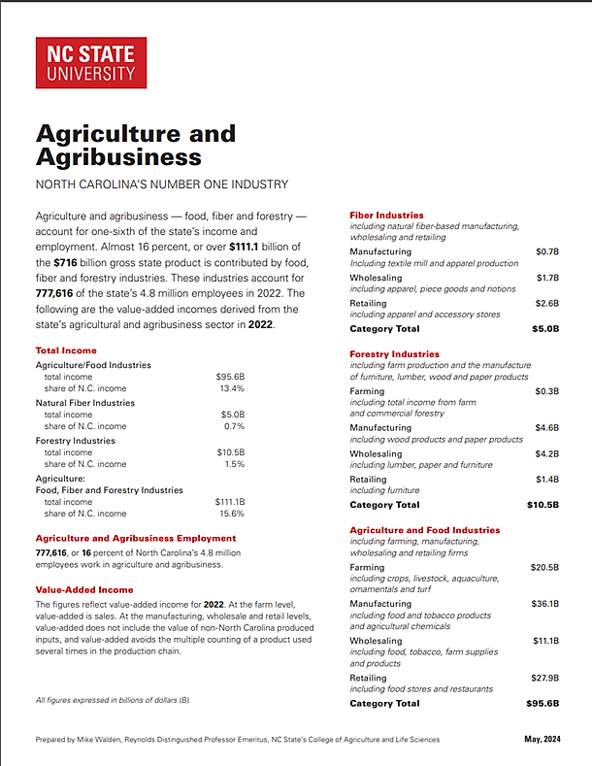
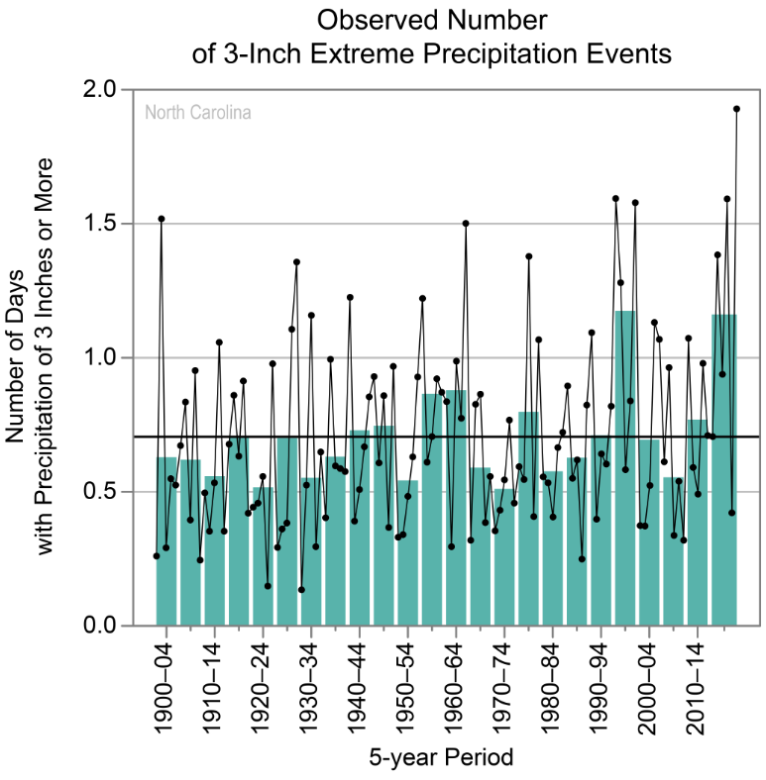
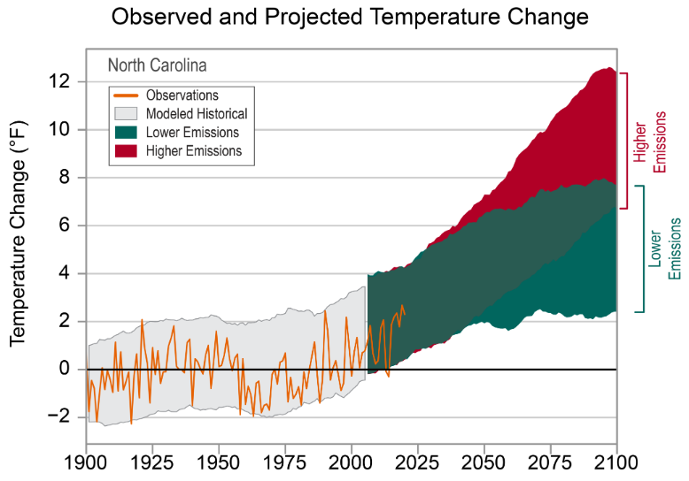
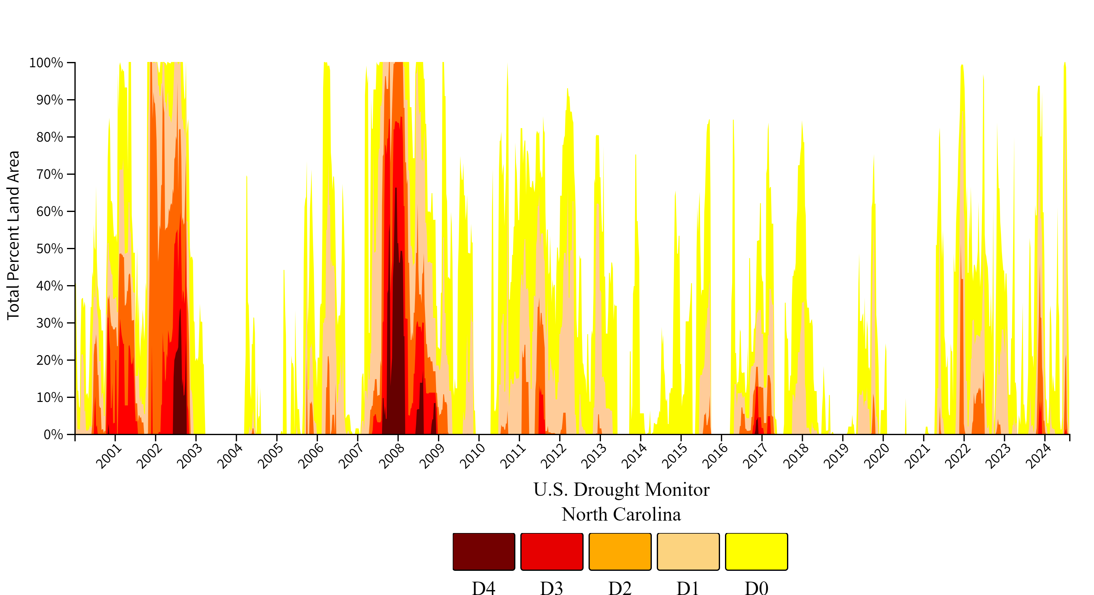
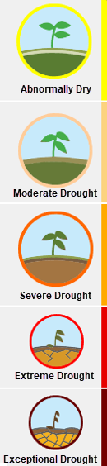
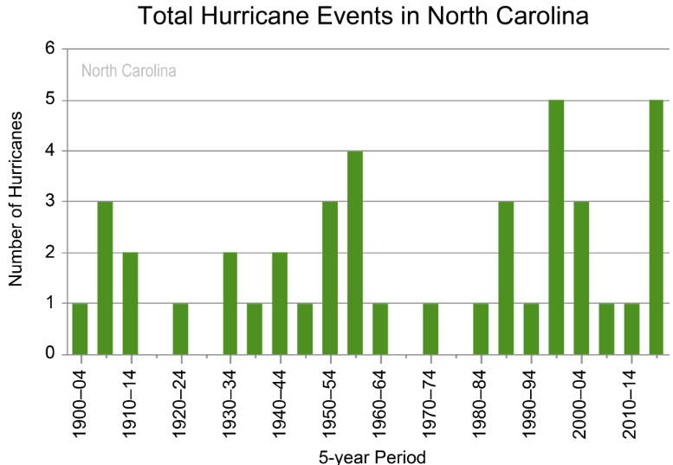
BACKGROUND
[ Warming trends and changes in precipitation patterns across the state …. Importance of agriculture to NC …]
Notes:
Precipitation - dots show annual values, bars show averages over 5-year periods (last bar is a 6-year average), and the horizontal black lines show the long-term (entire period) averages
Temerature - bserved and projected changes (compared to the 1901–1960 average)

Slide 5


APPROACH
Embedding
[ Warming trends and changes in precipitation patterns across the state …. Importance of agriculture to NC …]
Weather Data
(Wx)
VECTOR STORE
I/O HANDLING
Data By Season
Temperature
Precipitation
Disaster
Assistance
Program Info
Model
Insurance
Program Info
Prompts
Agricultural
Data (Ag)
Data By Crop Type
Acreage Planted
Production
Yield
Price per Unit
Production Value
Ag Best
Practice Info
Parsers
RAG
LLM
Inputs
ML
Performance
Prediction
Model
Decision
Support
Model
Regression Analysis
Retrieval & Synthesis
TRAINING DATA
CROP
YIELDS
Crop Type
Location
PRODUCTION VALUE / ACRE
Timeframe
Crop Types
Barley Blueberries*
Corn Cotton Hay Oats Peanuts
Bell Peppers Pumpkins Soybeans Squash Sweet Potatoes Tobacco Wheat
CONFIDENCE LEVELS
Gradio
Outputs
Agent
Recommendation
TEMPERATURE
PRECIPITATION
Wx
Forecast
Customized
Crop Planning & Protection Plan

Slide 6
MODELING AND ANALYSIS
Machine Learning Modeling
RAG Design
Message Handling Model (LLM)
Decision Model

Slide 7
RESULTS AND CONCLUSIONS
Impact of Weather to Crops
Perform of Models

Slide 8




















ADDITIONAL INVESTIGATION AREAS
MODEL LIMITATIONS
Geospatial Exploration
Location-specific weather and harvest data may reveal information about the impacts of topography (elevation and soil content) on crop yield
Enhanced Weather Data
Additional weather features such as humidity levels, atmospheric pressure and solar irradiance may reveal additional weather influences on yield
Infestations and Disease
Data related to crop-destroying insect populations and disease occurrences as well as pesticide use may reveal new insights on [WHAT?]
Influences of Farming Practices
Individual farming practices are likely to have a material influence on historic harvest data and are not accounted for in the model
Genetic Engineering Techniques
Model does not account for the use of seeds genetically modified for increased drought tolerance or pest resistance

Slide 9
REFERENCE CONTENT
GitHub
Project Repository: github.com/mikeszumski/AgProject3
Contributors
Michael Szumski | @mikeszumski (data wrangling, public health analysis)
Jamie Bond | @JBondAI (dataset identification, storytelling)
Data Providers

Slide 10
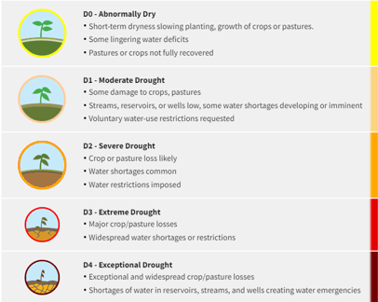
Place holder

Slide 11
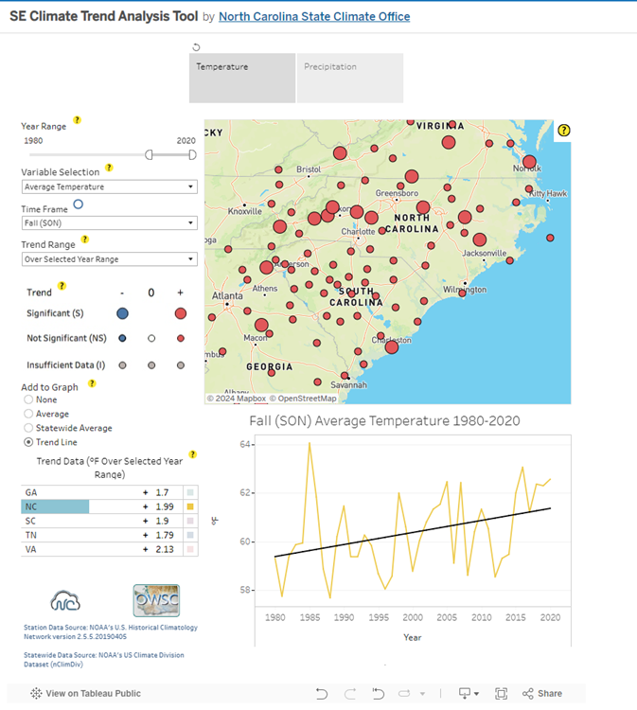
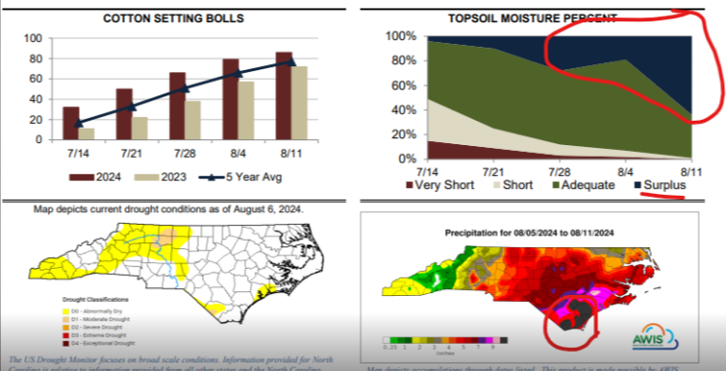
Precipitation and Temperature Data Source
https://public.tableau.com/app/profile/north.carolina.state.climate.office/viz/SEClimateTrendAnalysisTool/TrendAnalysisTool

Slide 12
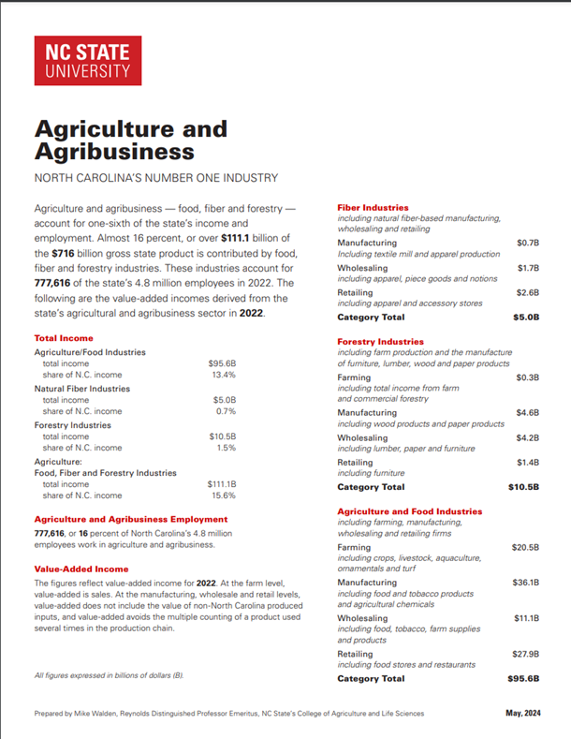
https://cals.ncsu.edu/agricultural-and-resource-economics/wp-content/uploads/sites/46/2017/07/AgricultureAgribusinessReport-2023-digital.pdf

Slide 13
APPROACH
Seasonal
Weather Data
(Wx)
FEATURES
Temperature
Precipitation
VECTORIZATION
CHAINING
Disaster
Assistance
Program Info
Prompts
Agricultural
Data (Ag)
TARGETS
Corn Yields
[Crop] Yields
[Crop] Yields
ML
Agriculture
Prediction
Model
Insurance
Program Info
Parsers
Harvest Prediction
Model
MODEL TRAINING
LLM
DA
Decisioning & Recommendation Model
Crop
Types
HARVEST
YIELDS
Net Benefit
PROFITABILITY
SEED COSTS
Wx
Forecast
CONFIDENCE LEVELS
COMMODITY PRICING
Financial Prediction
Model
TARGETS
Seed Costs
Commodity Pricing
Farm Protection Plan
Financial
Trends ($)
MODEL TRAINING
Notes:
Model takes precipitation and temperature
Find relationships plant advisor
Conditions

Slide 14
Planning and Protecting North Carolina Farmland against Climate Change
COURTESY OF:
Mike Szumski and Jamie Bond

